Slide 1



Evolving your app from Xamarin.Forms to .NET MAUI
Maddy Leger
Xamarin/.NET MAUI Program Manager
@maddyleger1 | maddy@microsoft.com

Slide 2




.NET Multi-platform App UI
.NET 6
Cross-platform, native UI
Single project system, single codebase
Deploy to multiple devices, mobile & desktop
General availability in .NET 6
.NET Multi-platform App UI
WinUI
Mac Catalyst
iOS
Android
macOS
iOS
github.com/dotnet/maui

Slide 3

TL;DR
Now: Don’t panic!
Soonish: Get up-to-date with Xamarin.Forms
Later this summer: Make a branch, use Upgrade Assistant, and see where you’re at
Give us some feedback, rinse, repeat
Bonus Step: Single project-ify!

Slide 4
Don’t Panic!!!!!
FAQs from customers like you

Slide 5

Is Xamarin dead?!?!?!
No! !!!! !!!!!!!!!!! .NET MAUI and .NET 6 are an evolution!
Do I need to rewrite my apps?
Also no!!!!
What happens to Xamarin.Android? Xamarin.iOS?
They’re just .NET for Android and .NET for iOS now!
When do I start trying to migrate?
Get up to date now, but there is no rush. You have till Nov 2022
Should I use .NET MAUI or <insert framework here>??

Slide 6
Get up to date

Slide 7
Evolving the Architecture
Renderers are tightly coupled to Xamarin.Forms and Xamarin.Forms components
Handlers are unwrapped, decoupled, portable, and reusable
OLD
NEW
Microsoft.Maui.Controls.Entry
EntryRenderer
Xamarin.Forms.Entry
CometEntry
IEntry
EntryHandler
FabulousEntry
ReactiveEntry

Slide 8
DO NOT
DO
Remove unnecessary custom renderers
Use AppCompat/AndroidX
Use Fast Renderers
Purchase a Hawaiian Shirt
Upgrade to the latest reasonable Xamarin.Forms for you
Use source control!!!!!
Use obsoleted APIs
Panic!!!!!
Use DataPages or Themes NuGets
Neglect your app for the next 6 months

Slide 9
What if I still need a Xamarin.Forms control?
Microsoft.Maui.Compatibility package is installed with .NET MAUI
.ConfigureMauiHandlers(handlers =>
{
#if WINDOWS10_0_17763_0_OR_GREATER handlers.AddCompatibilityRenderer<ImageButton, Microsoft.Maui.Controls.Compatibility.Platform.UWP.ImageButtonRenderer>();
#elif ANDROID
handlers.AddCompatibilityRenderer<ImageButton, Microsoft.Maui.Controls.Compatibility.Platform.Android.ImageButtonRenderer>();
#elif IOS || MACCATALYST handlers.AddCompatibilityRenderer<ImageButton,
Microsoft.Maui.Controls.Compatibility.Platform.iOS.ImageButtonRenderer>();
#endif
});

Slide 10

So… then what?
Upgrade assistant!!!!

Slide 11

https://github.com/dotnet/upgrade-assistant

Slide 12
What does it do?
Backup project
Convert project file to SDK style (try-convert)
Update TFM (try-convert)
Update NuGet packages/move to nuget.config
Add template files
Migrate app config files
Update C# source
Move to next project
Before
After
Xamarin.Forms project (.NET Standard)
Xamarin.Android project (Mono.Android)
Xamarin.iOS project (Mono.iOS)
.NET MAUI project (.NET 6 with multitargeting)
.NET Android project (net6.0-android)
.NET iOS project
(net6.0-ios)

Slide 13
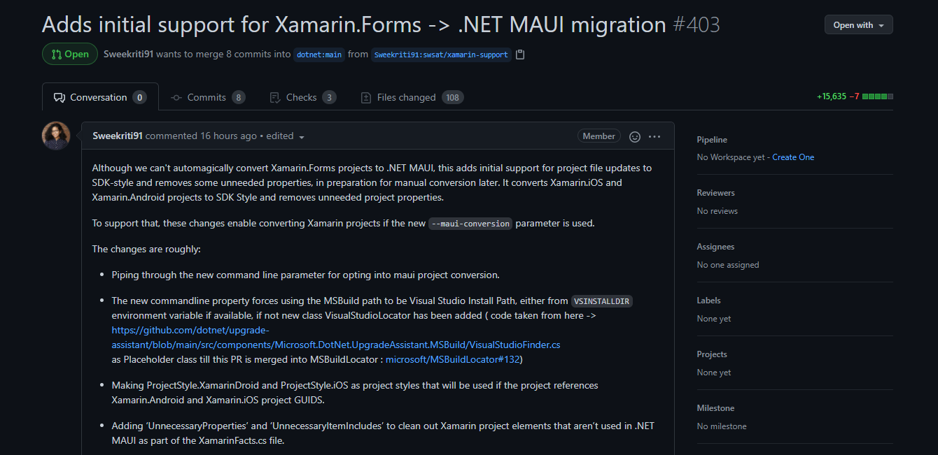
try-convert
Updates target framework monikers (TFMs) and converts project files
Runs as part of Upgrade Assistant
Multitargeting for .NET MAUI proj
https://github.com/dotnet/try-convert

Slide 14
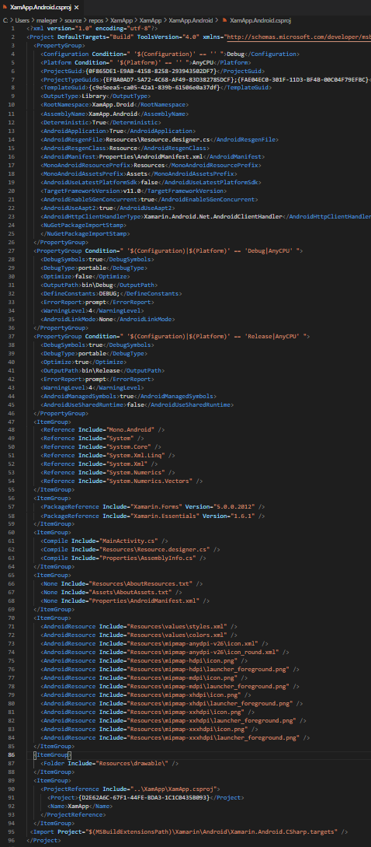
Project Files: Before and After
Reference
PackageReference
Compile
Resources
AndroidResource
Folder
Project GUID
Debug/Release configs
<Project Sdk="Microsoft.NET.Sdk">
<PropertyGroup>
<TargetFramework>net6.0-android </TargetFramework>
</PropertyGroup>
...
</Project>

Slide 15
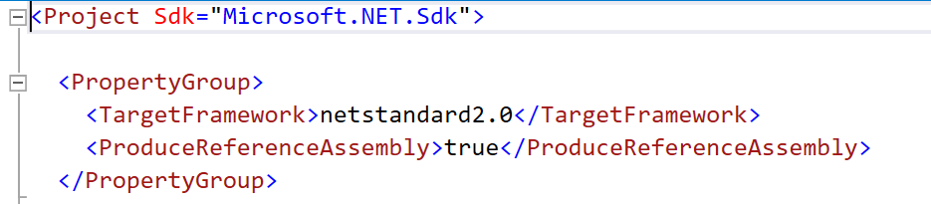
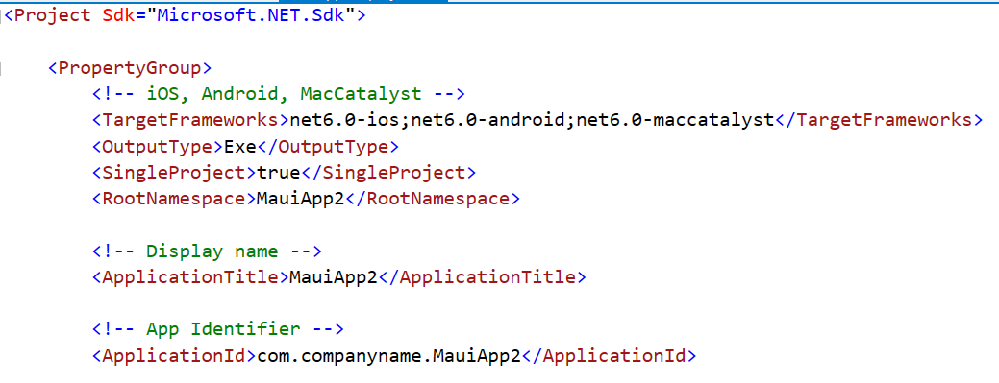
Project Files: Before and After

Slide 16
C# Source Changes we’ll do for you
Xamarin.Forms -> Microsoft.Maui
Xamarin.Essentials -> Microsoft.Maui.Devices
XAML namespaces
Color.[NamedColor] -> Microsoft.Maui.Colors.[NamedColor]
…and probably more!

Slide 17
No, this won’t be perfect
UWP (and other non-.NET 6 platforms) are not supported
Probably will require some manual cleanup (we’ll have blogs and docs, don’t worry!)
Will not get rid of “head” projects for you
Won’t move resources to MauiImage etc.
Won’t move platform-specific code
Please engage with us on GitHub, Twitter, etc!

Slide 18
Bonus: Single Project-ify

Slide 19
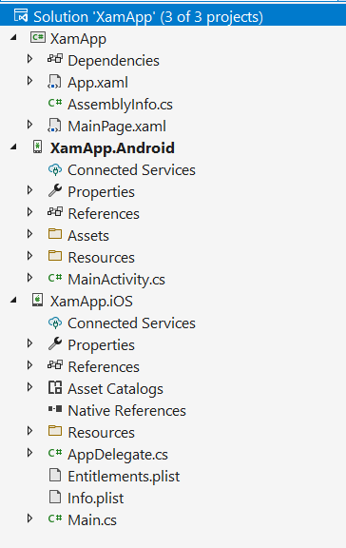
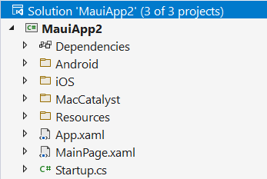

Slide 20
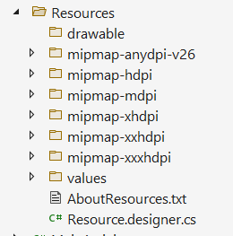
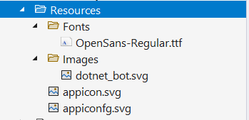
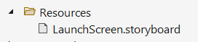

Slide 21

Why can’t Upgrade Assistant just do it for me???
Maybe it will, eventually?! But not at first.
Much higher likelihood of us breaking/misplacing your resources and files
Single project is still very much under active development

Slide 22
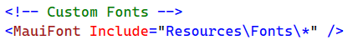
Steps to single project-ify
Fonts
Move the OTF/TTF to shared Resources, register it in Startup.cs
Launch Screen
If it’s simple, can use an image and background color instead

Slide 23
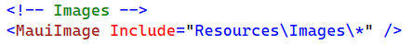
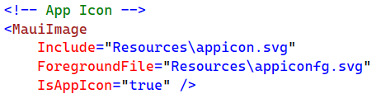
Steps to single project-ify
Images
Move them over as individual resolutions to the platform folders or Resources folder
Or… replace them all with SVG!
You don’t have to do all of them at once!
App Icon
Foreground and background images!

Slide 24

Resources

Slide 25
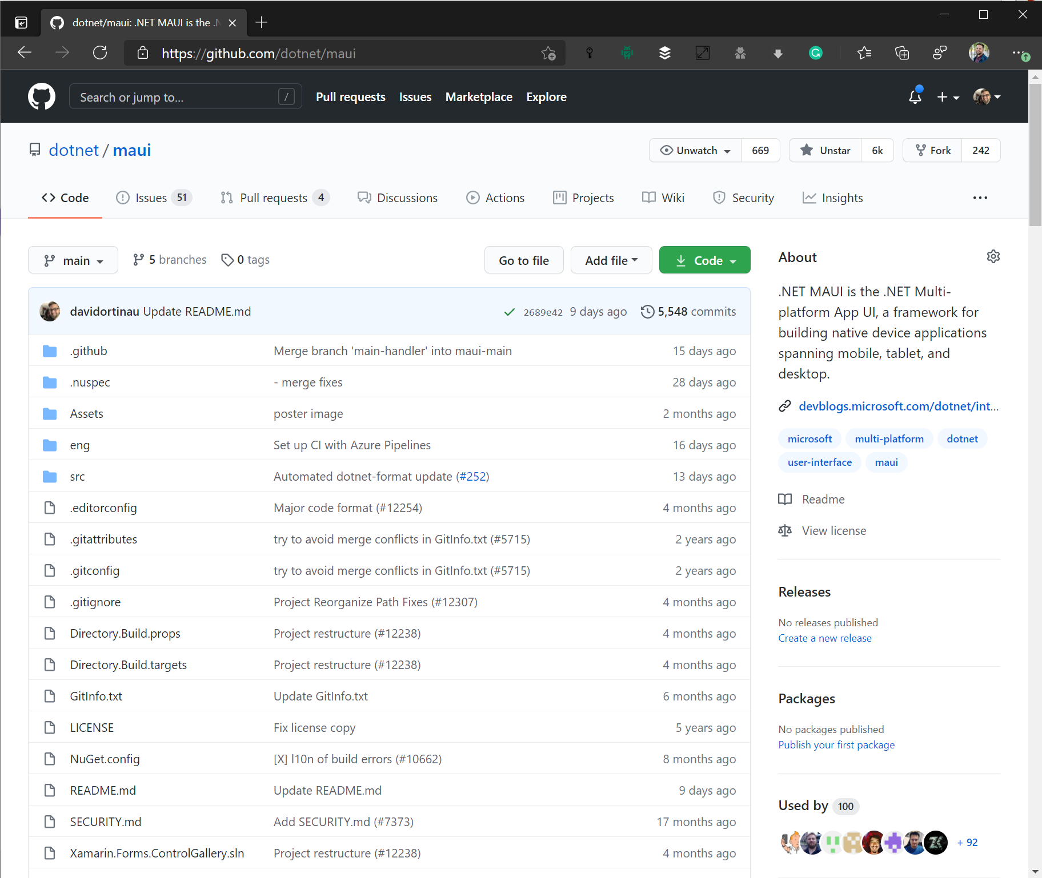
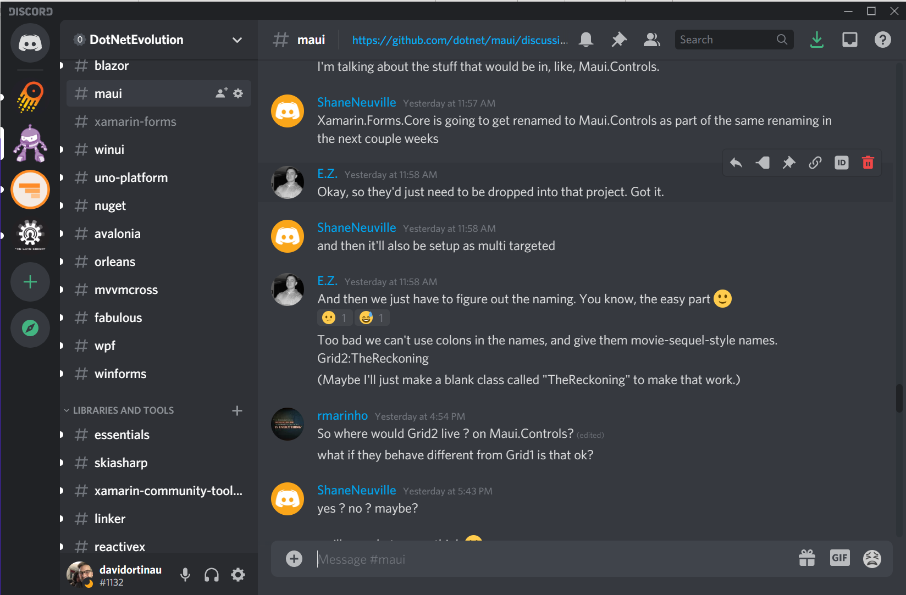
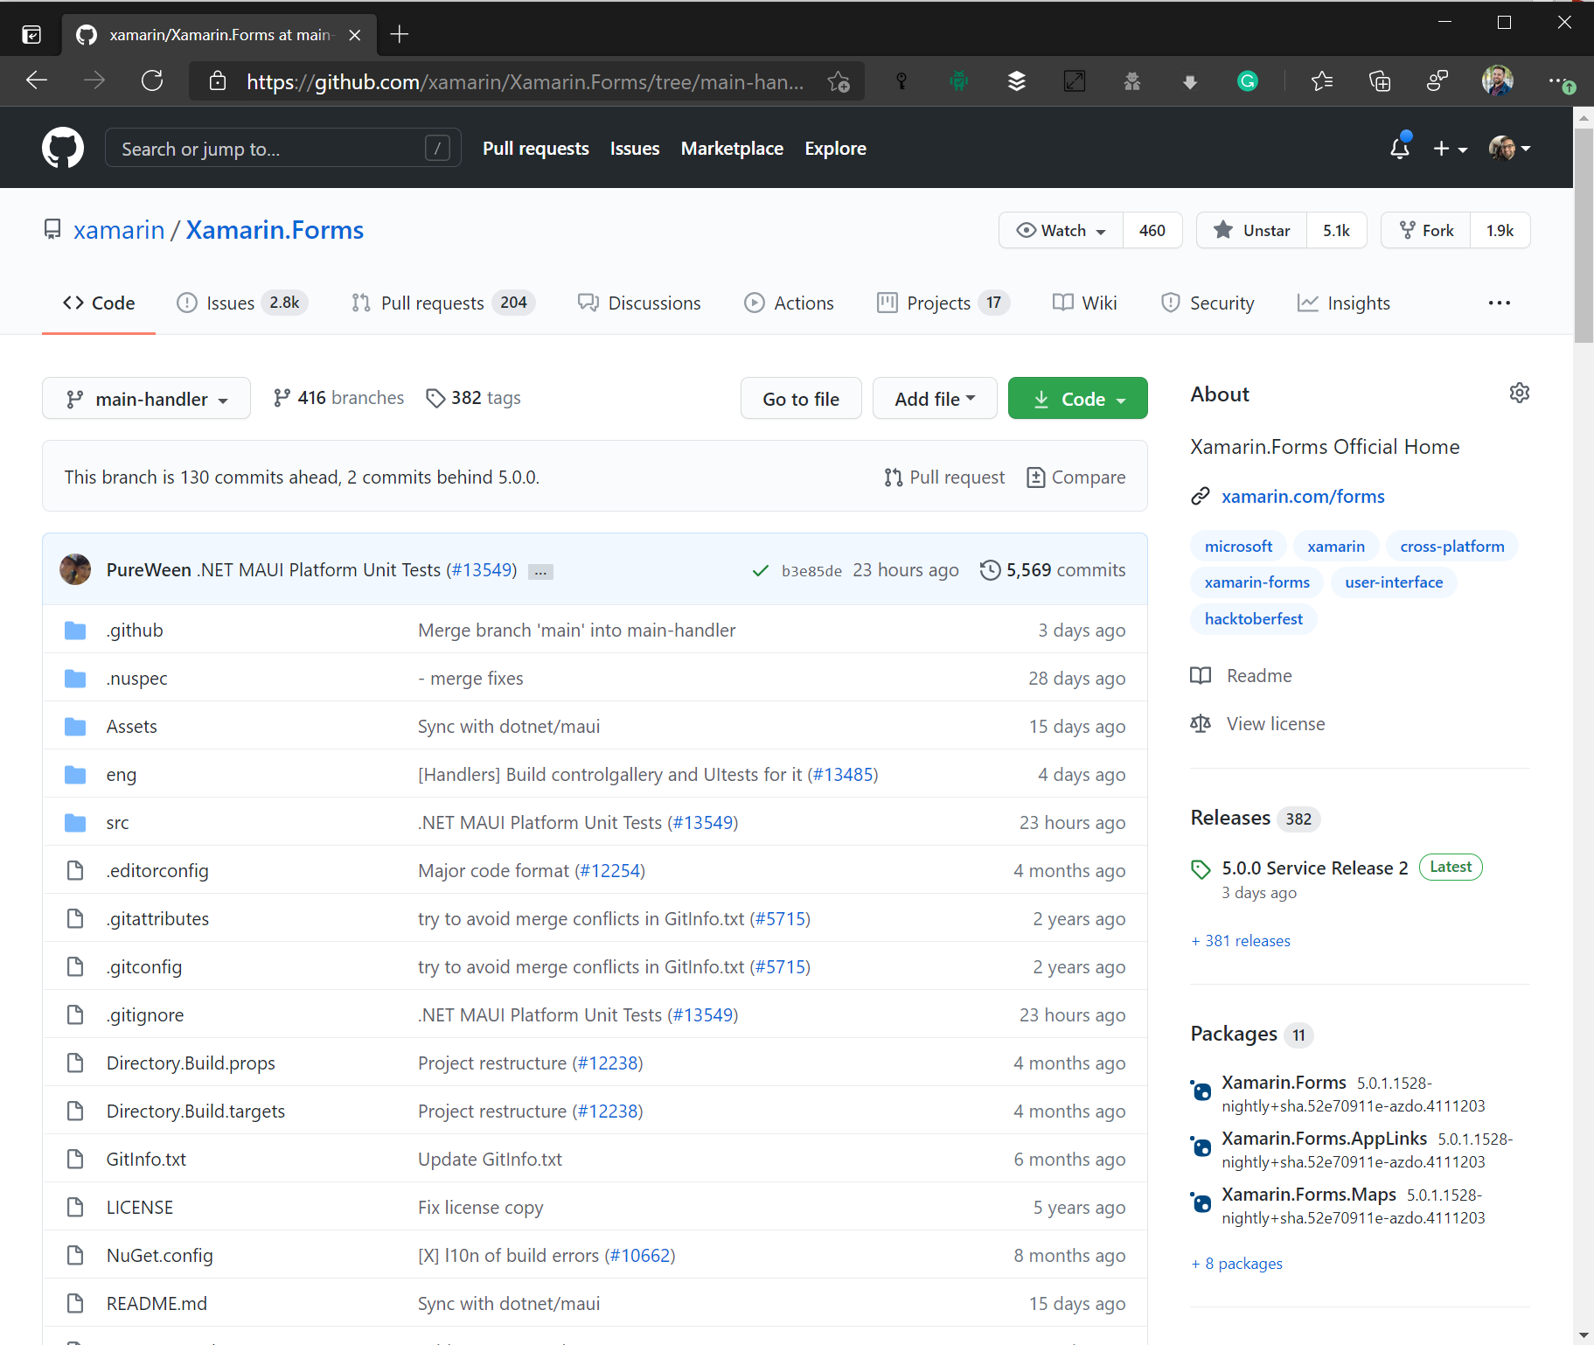
Where is this happening?
https://aka.ms/discord-maui
https://github.com/dotnet/maui

Slide 26
OSS Library Maintainer - Monthly Sync
1st Tuesday of the Month @ Noon PT / 3 ET
Teams Call to deep dive on architecture and ask ?s
Current representation from:
FreshMvvm
Mobile Build Tools
MvvmCross
Prism
ReactiveUI
Shiny
Xamarin Community Toolkit
Uno Platform
To join:
📧 david.ortinau@microsoft.com

Slide 27
Timeframe
November 2020
Announcements and Plans begin
Begin building migration help and producing guidance
November 2021
Xamarin.Forms 5.x with latest iOS and Android support
.NET MAUI GA
November 2022
Xamarin.Forms end of support
.NET MAUI vNext

Slide 28
Evolving your app from Xamarin.Forms to .NET MAUI
Maddy Leger
Xamarin/.NET MAUI Program Manager
@maddyleger1 | maddy@microsoft.com

Slide 29







Slide 30








Slide 31









Slide 32









Slide 33




